Slide 1
Plumas Emergency Forest Restoration Team (EFoRT)
Notes:
Michael

Slide 2
What is the EFoRT?
Established through the “California Wildfire and Forest Resilience Action Plan” (January 2021)
Action Item 1.14- “CALFIRE and other State agencies will explore the potential for developing emergency forest restoration teams to assist small landowners impacted by wildfires with funding and expertise to restore their properties and help prevent further damage to life, property and natural resources”
This Photo by Unknown Author is licensed under CC BY-SA
Notes:
Michael
Plumas effort is second in the state, being established concurrently with Eldorado/ Caldor. Another EFRT style initiative is being established in Alpine county. State estimates a need for 8 EFRTs by 2023. We are the guinea pig for this project

Slide 3
EFoRT Partners
Notes:
Michael
Funded through CALFIRE, the project works because it is planned locally, by Plumas based groups.

Slide 4
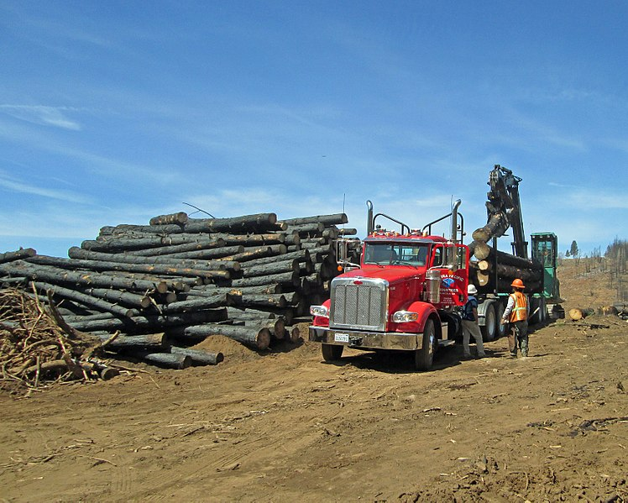
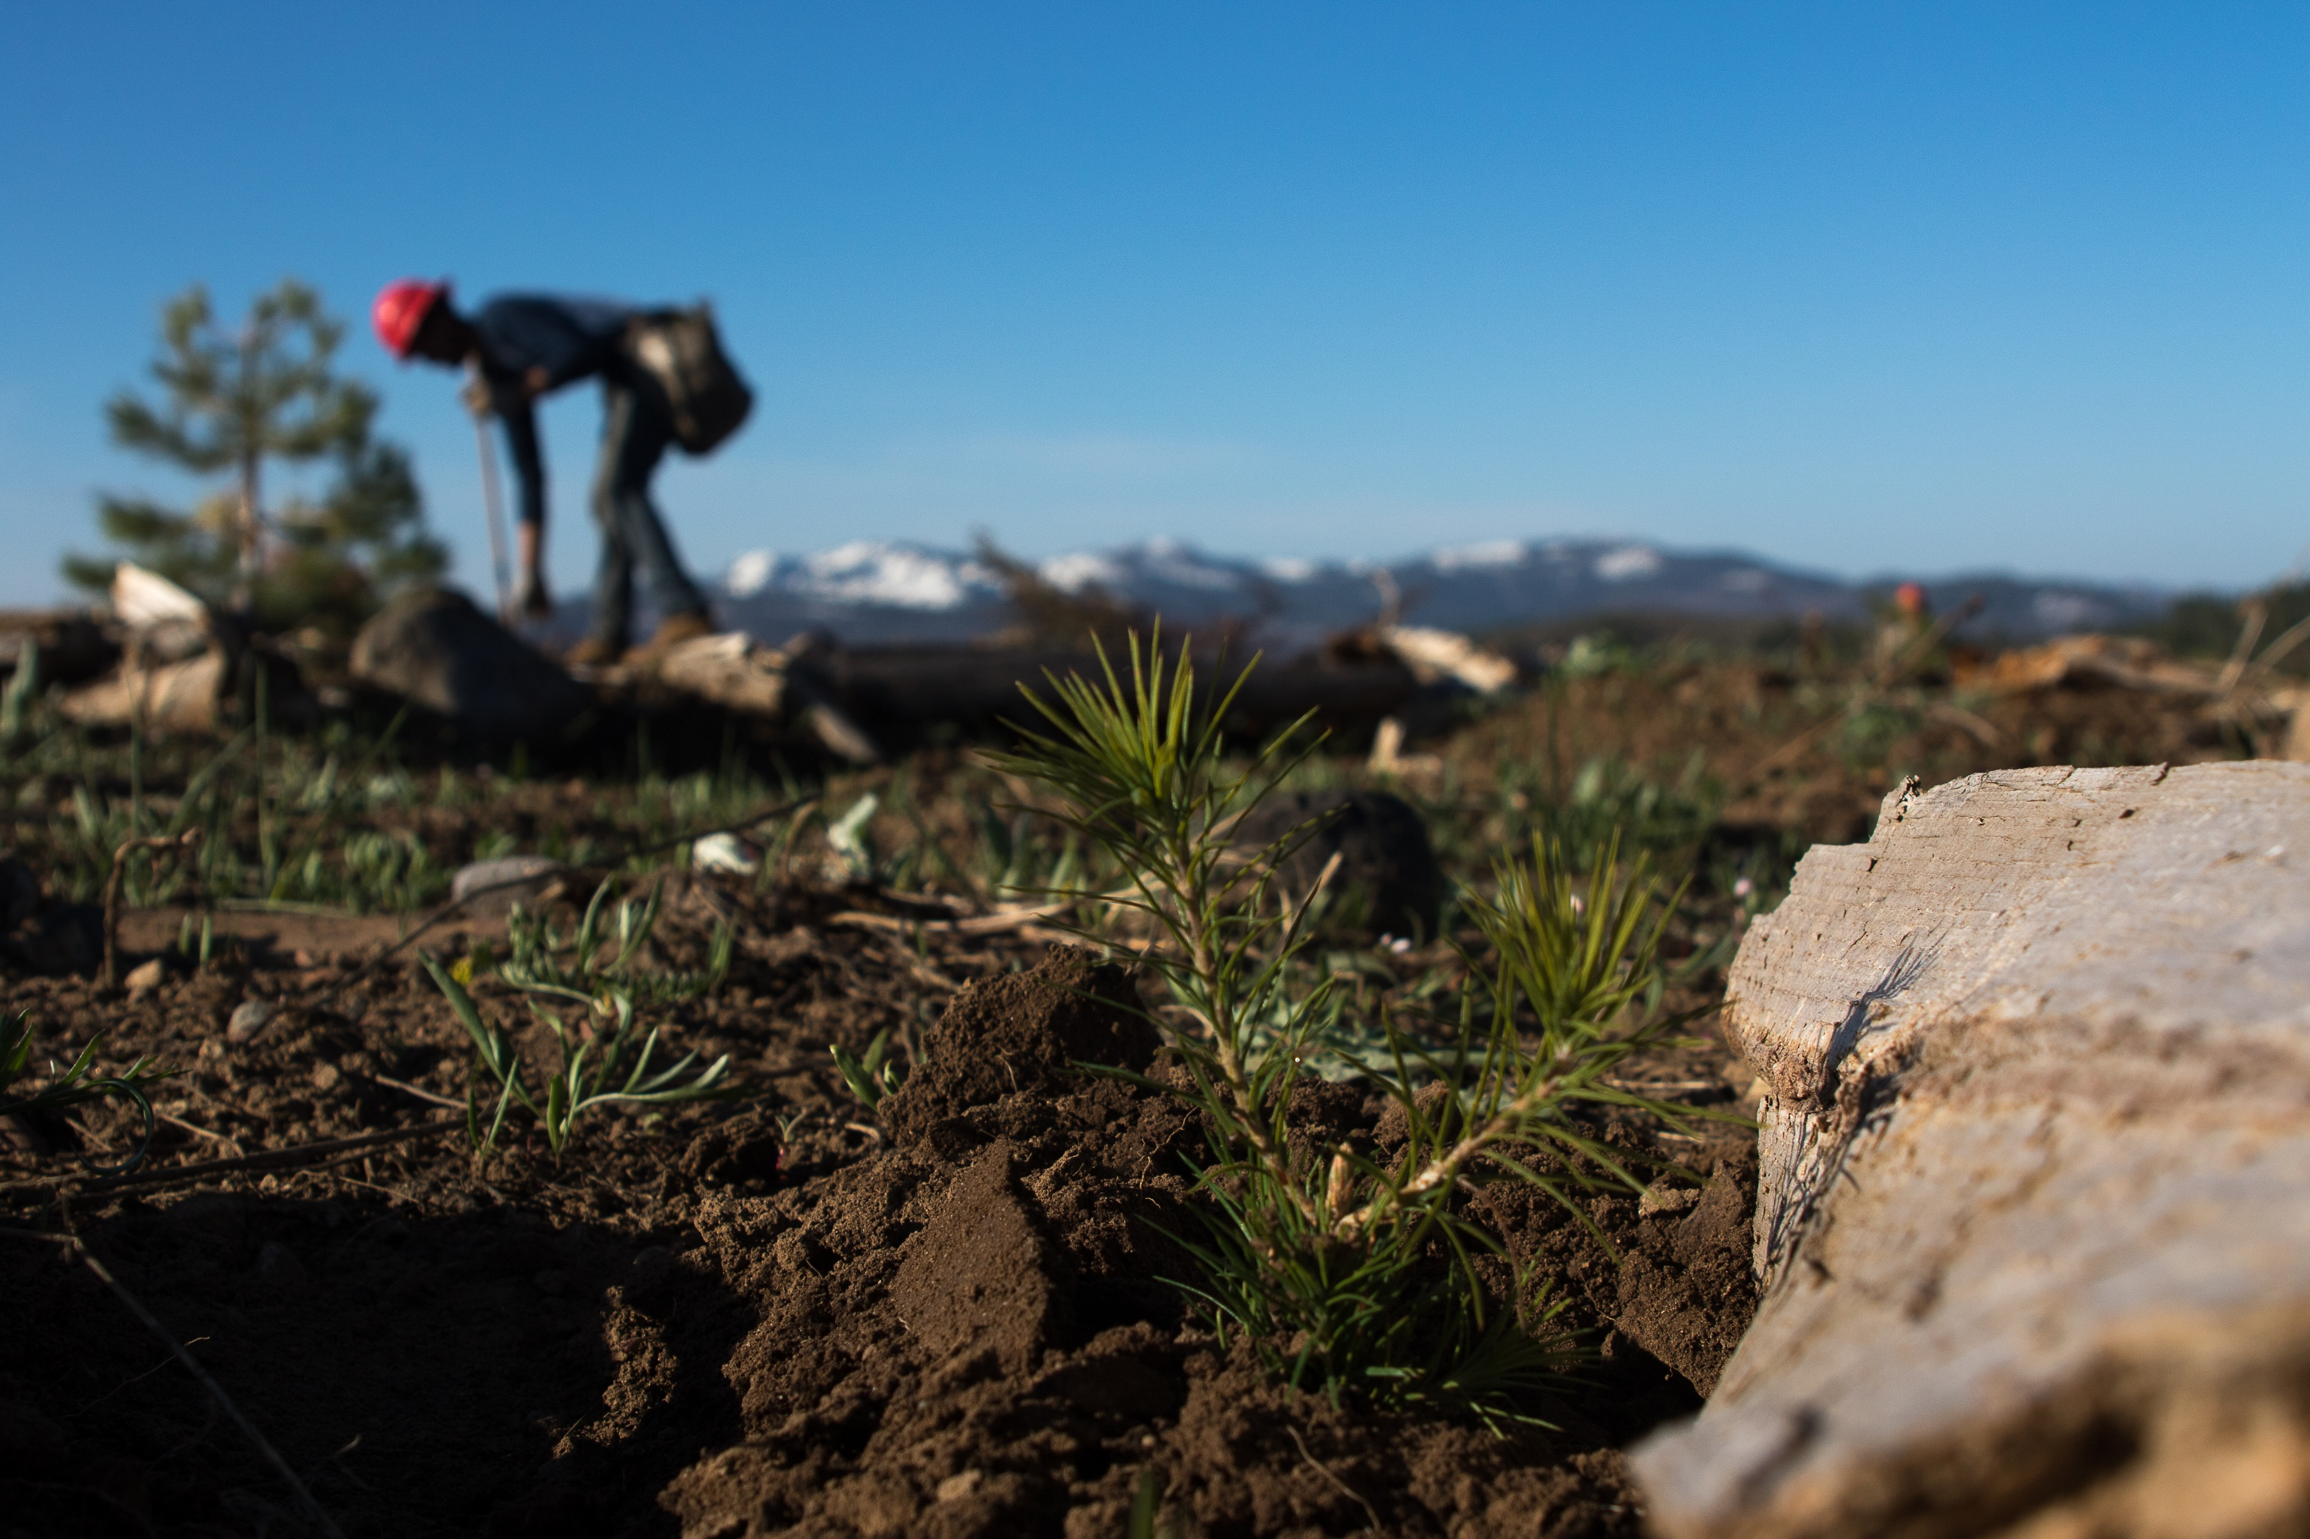
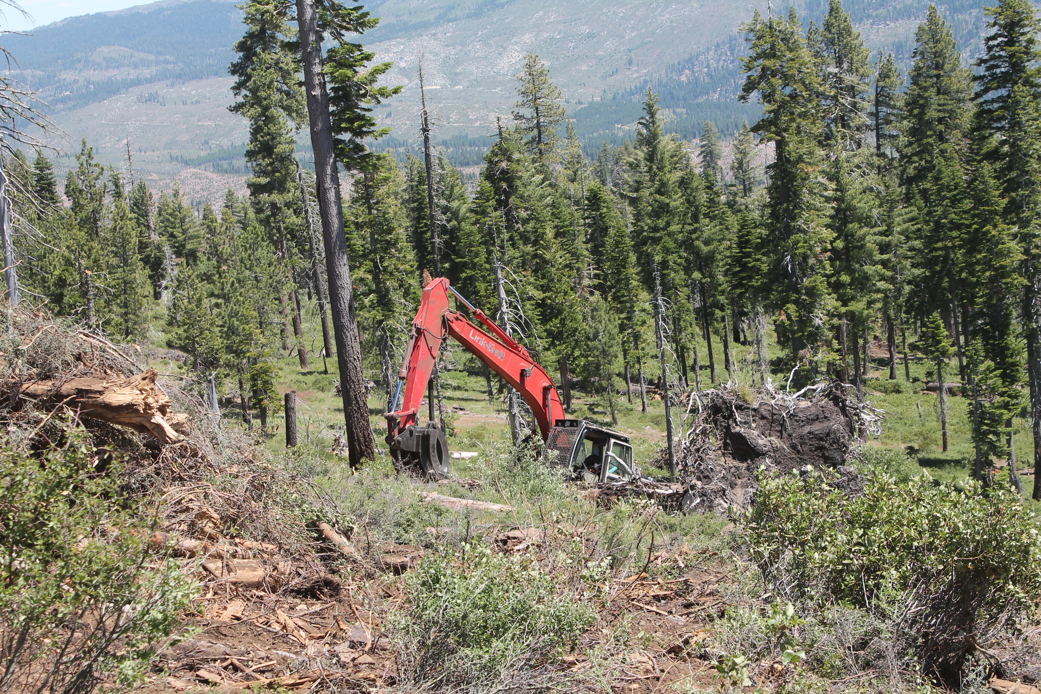
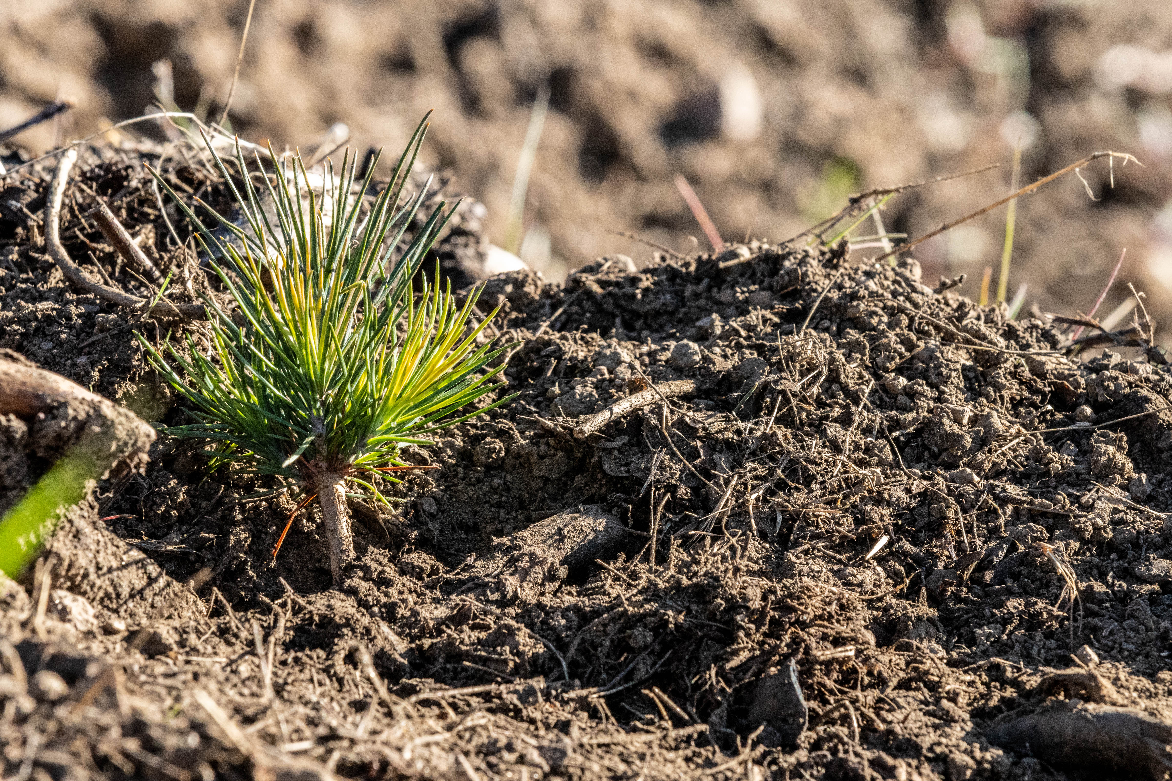
Scope of Work
Analyze NIPF lands to assess fire severity
Outreach and education
Develop forest restoration plans
CEQA compliance
Site preparation and fuel reduction
Address wood utilization and green waste removal
Reforestation
Follow- up release treatments
Efficacy monitoring
Notes:
Michael

Slide 5
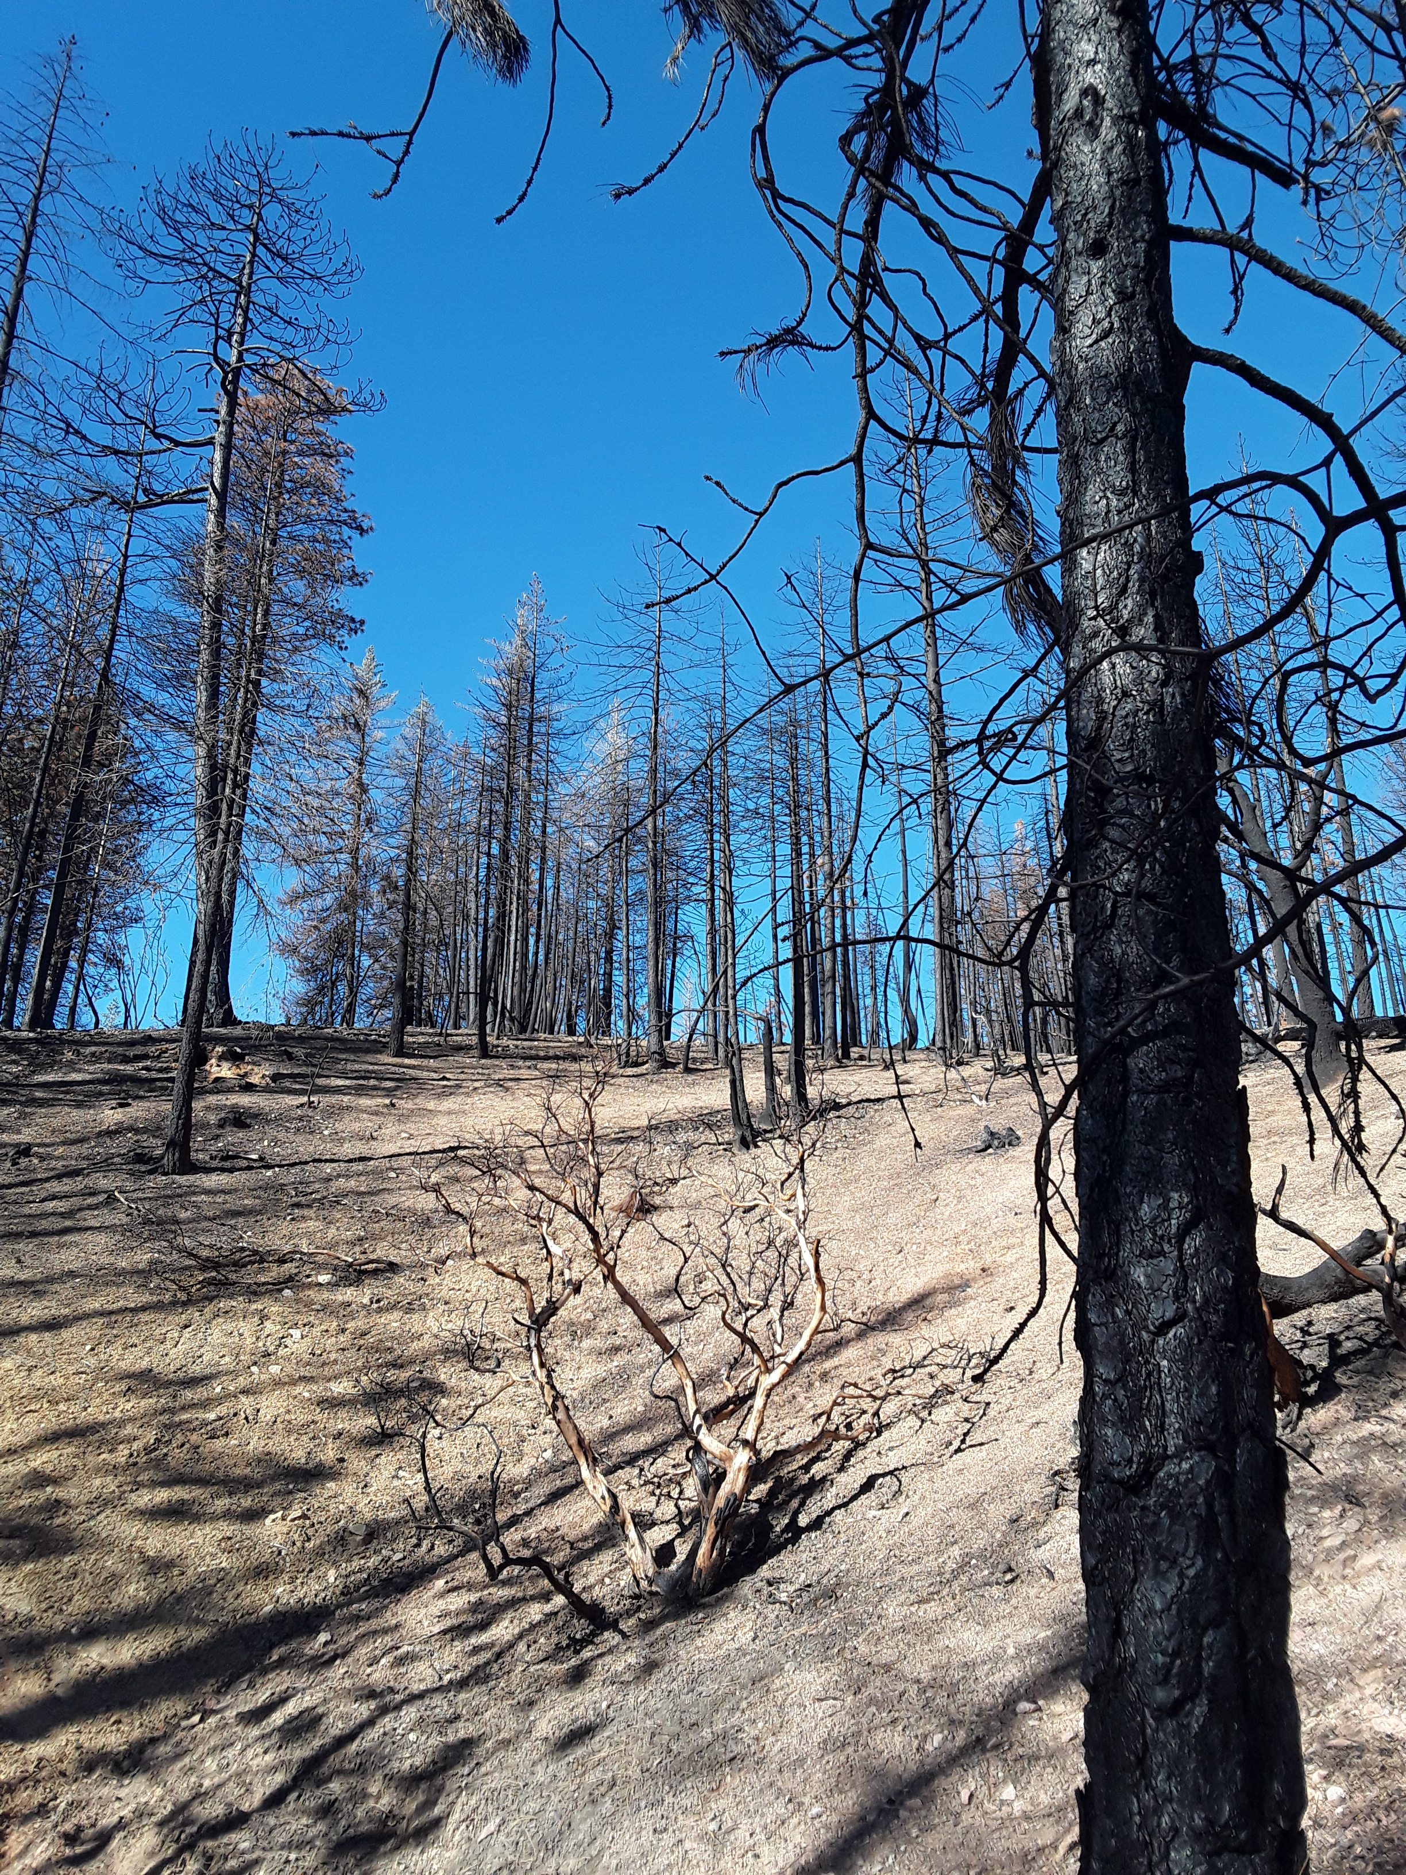
Complexity
EFoRT will work with individual landowners to create landowner specific restoration plans
Landowners can work with Registered Professional Foresters and EFoRT to select restoration treatments appropriate to their lands
EFoRT will coordinate between landowners and partners to address timing and delivery of work.
Multi-year Process
Notes:
Michael

Slide 6
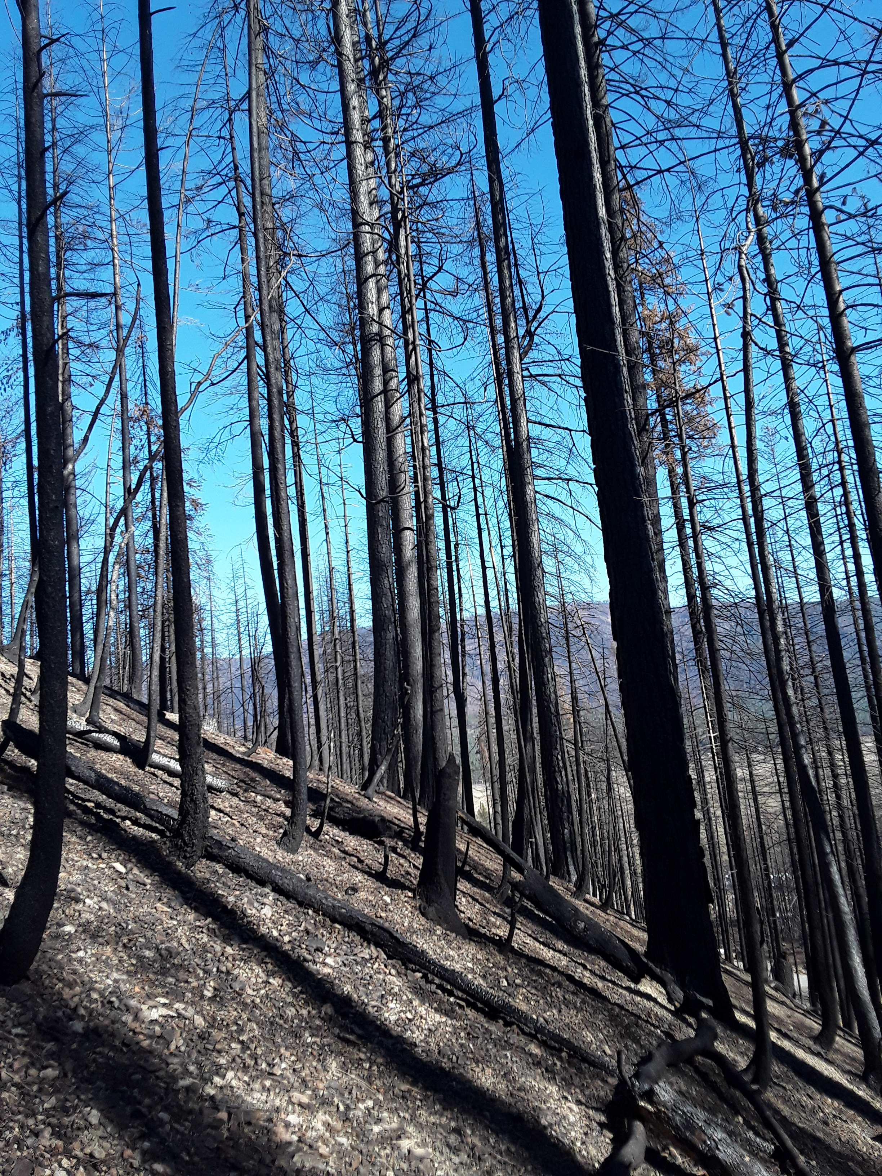
Eligibility
Non-Industrial Private Forest Landowners
Located within Plumas County
Within footprint of 2020/ 2021 Wildfires (North Complex, Beckwourth, Sheep, Dixie)
Priorities: WUI, Proximity to Communities and Infrastructure, Fire Severity
No work within 100 ft defensible space
High severity burn post Dixie on NIPF near Indian Valley
Notes:
Julia
NIPF – individual, group, tribal entity
We identified 19,730 acres of NIPF burned at moderate to high severity within the fire perimeter
WUI priority: Wildland urban interface, offer more protection against future fires

Slide 7
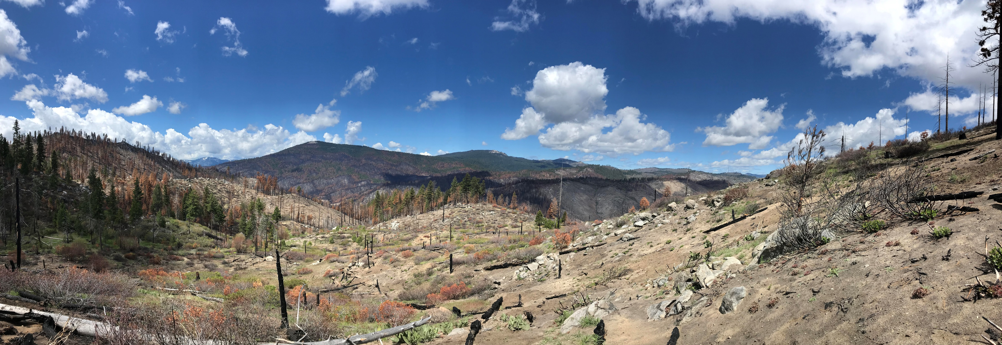
Two Ways to Fund Projects
Cap-Rate Reimbursements
Managed Contracts
Notes:
Describe why we chose to go this route. Cap rates support local operators already doing good work. Allow operations to continue and do needed restoration even if the economics aren’t there. Allow people to work with preferred operators
Managed contracts better for landowners who do not have an operator or operations already underway. Good for landowners who may not know what their options are. Takes burden off of operator or landowners.

Slide 8
Cap Rate Reimbursements
Establishes a cap-rate for restoration activities per acre
Rates based on NRCS/ CFIP / average operator rates
Adjusted Annually
Landowners/ operators will be reimbursed pending completion of project
Allows the landowner to choose Operator/ Contractor
Can still be used on properties with other funding, provided the same activity is not paid for twice
Notes:
Reiterating the fact that landowners will potentially want to use operators they know and trust, have already started doing the work, etc.
Landowners can potentially do the work themselves if they have the equipment and necessary insurance that would be required of an operator

Slide 9
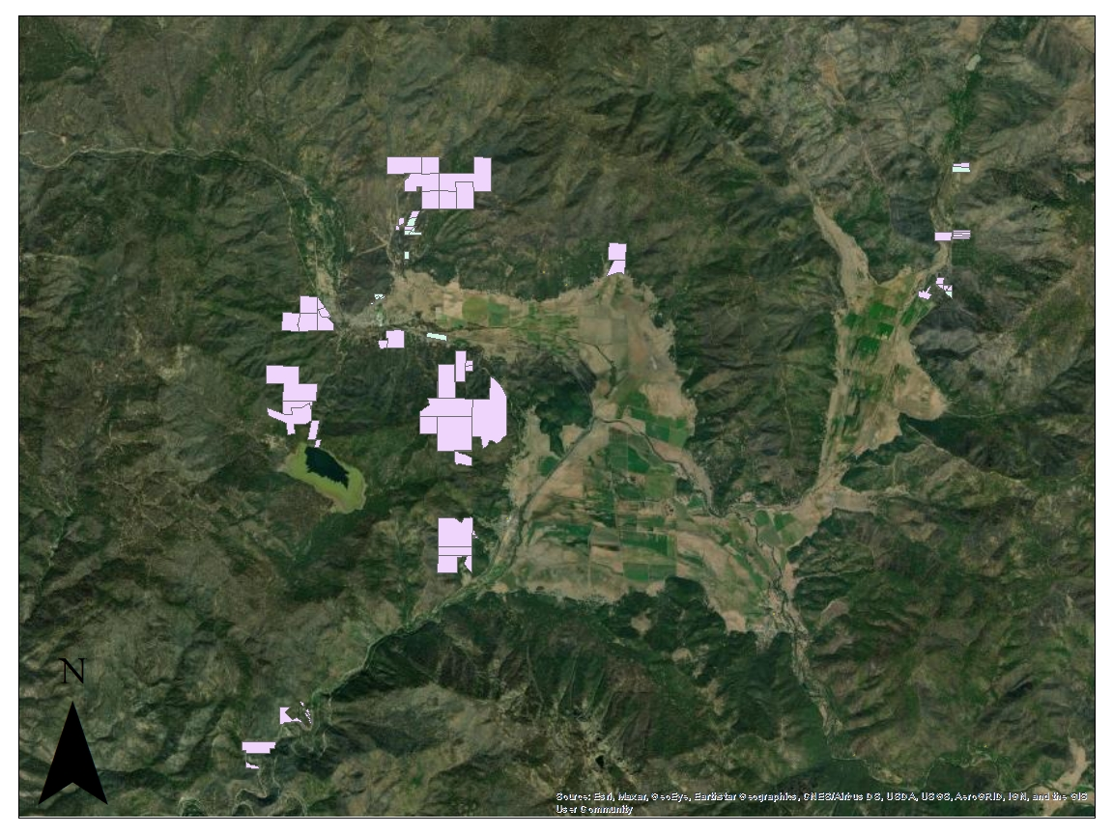
District Managed Contracting
FRRCD oversees operations
Landowners still involved with planning, will work with Registered Professional Foresters and Project Coordinators to create restoration plan
Project design will aim to incorporate many landowners into same work area
Competitive Bid Process

Slide 10
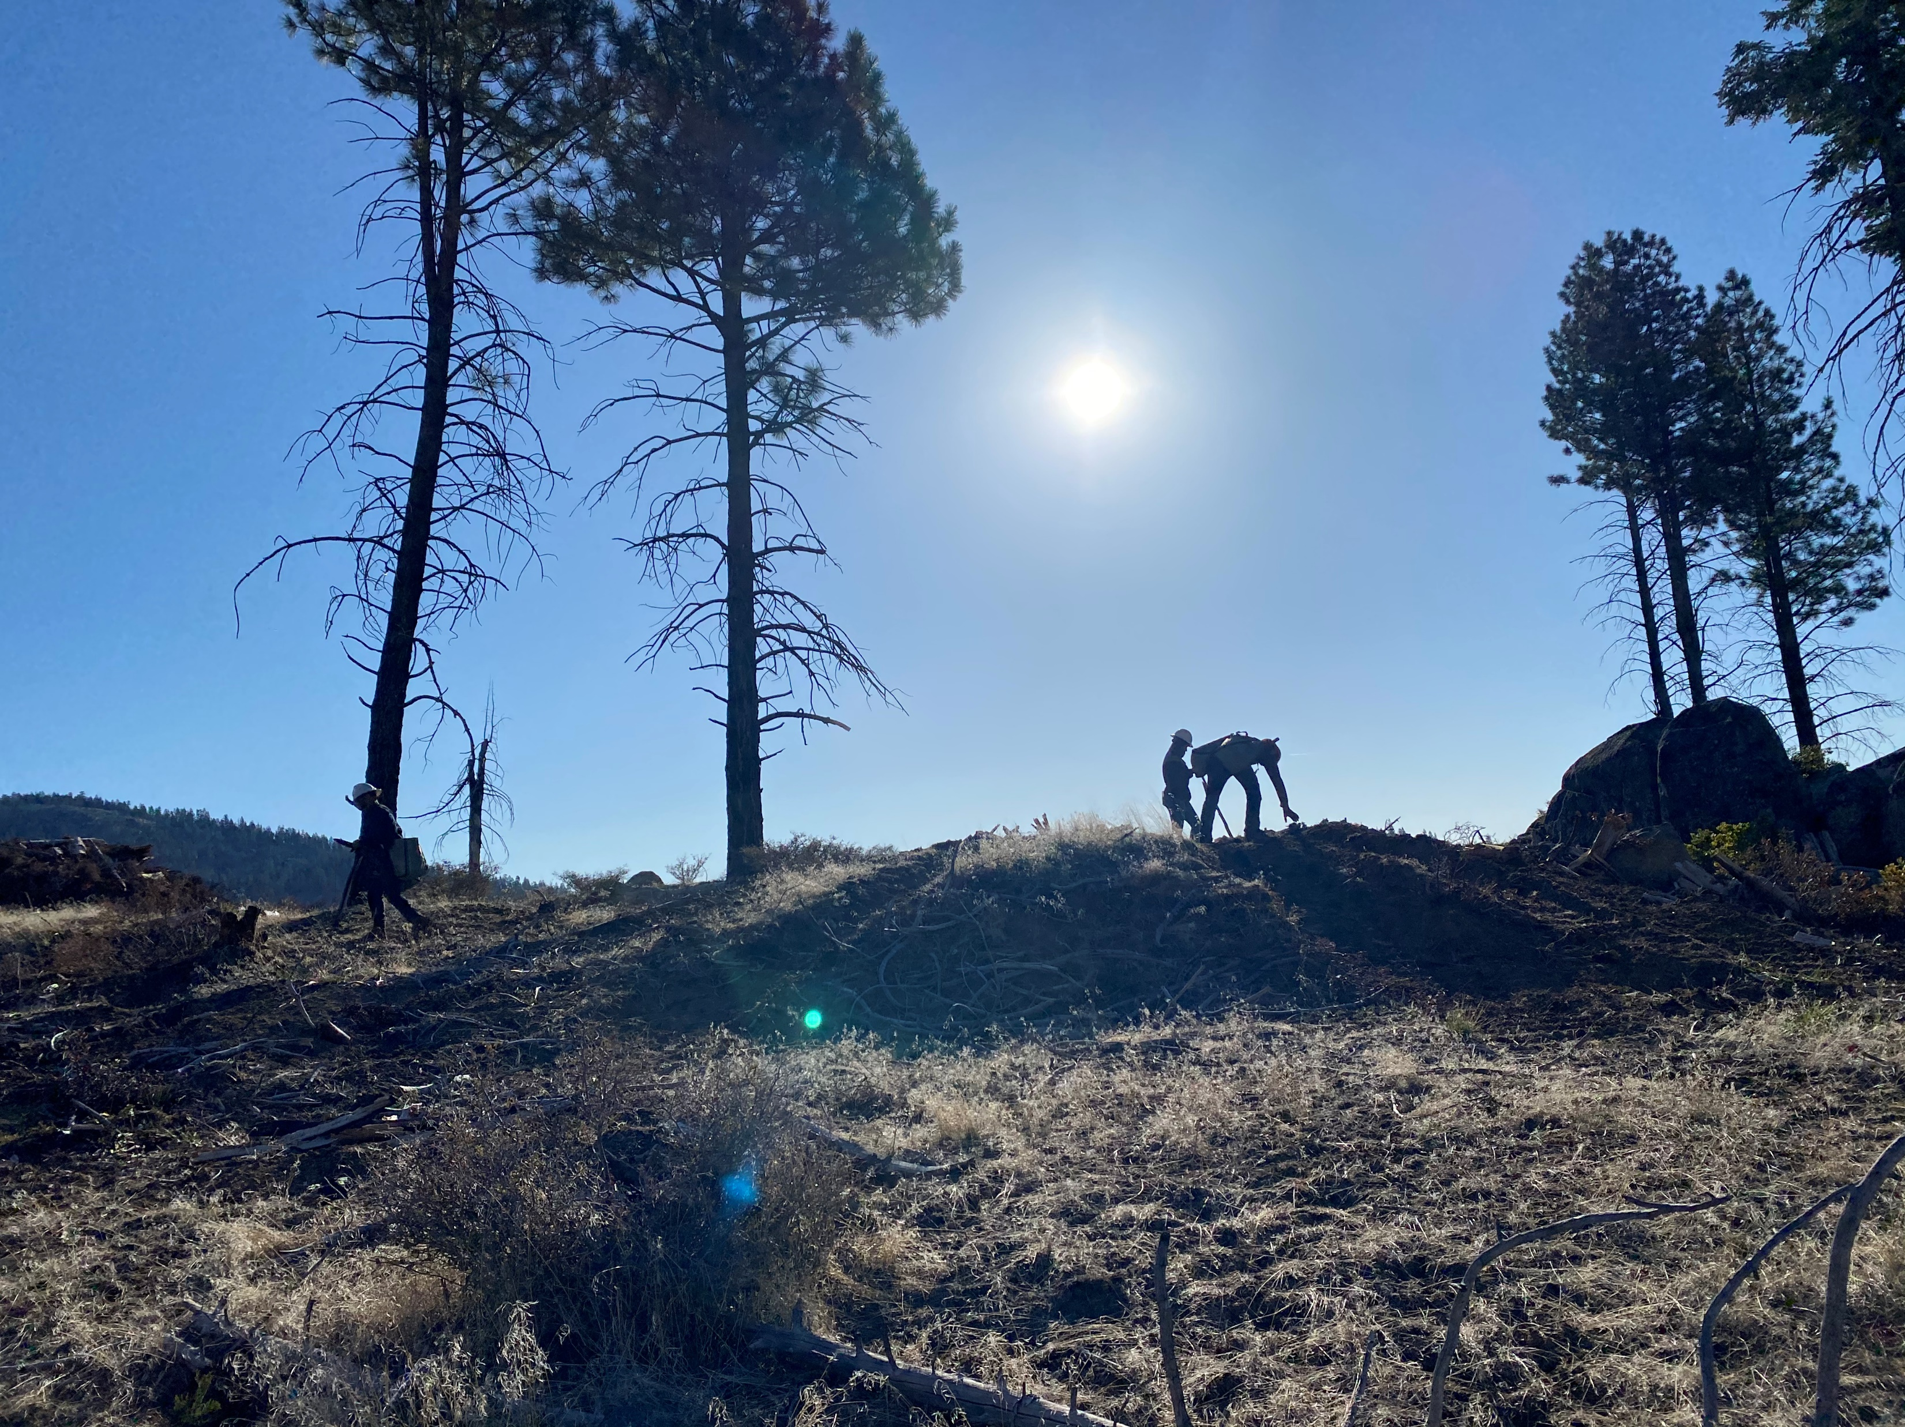
Timeline
May 2022- Program launch and Public outreach
June – November 2022- First phase site preparation; fuels reduction; wood utilization
Winter 2022/23- Enrollment/ Forest Restoration Plans/ Outreach/ CEQA
Spring- Fall 2023- Reforestation; phase 2 site prep; fuels reduction; wood utilization release
Continued Treatments through March 2026

Slide 11
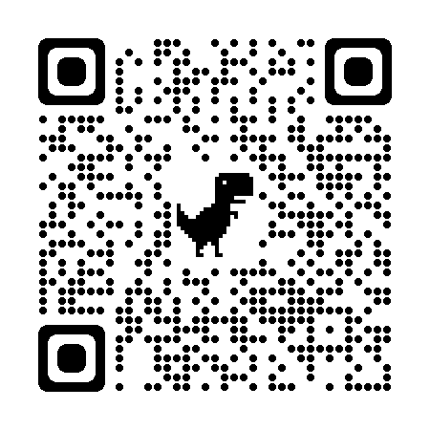
Enrollment
Visit www.frrcd.org
Fill out “Landowner Assistance Form”
A Project Representative will contact you
Schedule a no – cost site visit
Enter into Agreement with FRRCD; develop workplan
Notes:
QR code to landowner assistance form

Slide 12
Contact
Michael Hall
District Manager
mhall@frrcd.org
530.927.5299 ex. 104
Julia Sidman
Project Coordinator
jsidman@frrcd.org
530.927.5299 ex. 105

